Slide 1
KEY LOGGER: Intrusion & Detection
By: Internal Guide:
16WH1A1203(A.Chandana) Dr. S. L. Aruna Rao
16WH1A1222(G.Aruna) Professor & HoD
16WH1A1245(K.Shraddha)

Slide 2

What is a Keylogger?
It is a Malware, precisely a spyware.
A Keylogger = a software that logs key strokes.
At this basic level, a keylogger looks absolutely harmless.
In the hands of a hacker or a cybercriminal, a keylogger is a potent tool to steal away your information.

Slide 3
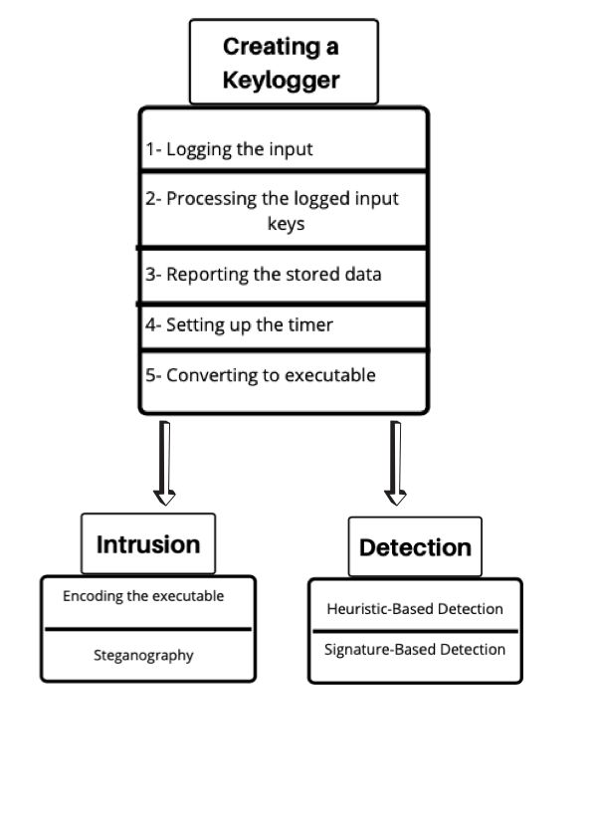
Architecture Diagram

Slide 4
Implementation
Module 1: Designing Keylogger
Module 2: Intrusion
Module 3: Detection

Slide 5
Module 1: Designing Keylogger
Keylogger is designed using following steps:
Pynput : used to take the keystrokes
Threading : for setting the time limit
Smtplib : sending mail from target computer
Exe file : converting python file to windows executable

Slide 6
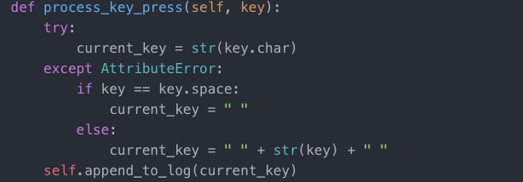
Code Snippet 1 – Logging keys

Slide 7
Module 2 : Intrusion
Any file or software has metadata. This metadata contains a signature on what type of contents are in the file or a software.
A different file is used to encode the contents of the software and make it look like normal executable to the anti-virus software.
By doing this, the keylogger can be successfully installed into the victim’s system.
Encode File : A file used to mask the signature of the keylogger, which helps the file to stay undetected by the antivirus.
Masked file : keylogger appears as a normal file and cannot be detected by user.

Slide 8
Module 3: Detection
Anti Virus is designed based on the following techniques:-
Signature Based Detection.
Heuristic Based Detection.
User Interface is done using Tkinter module in python.
For Signature based Technique the hash of the files is compared.
In Heuristic based, the process is scanned for forbidden commands and behaviors.

Slide 9
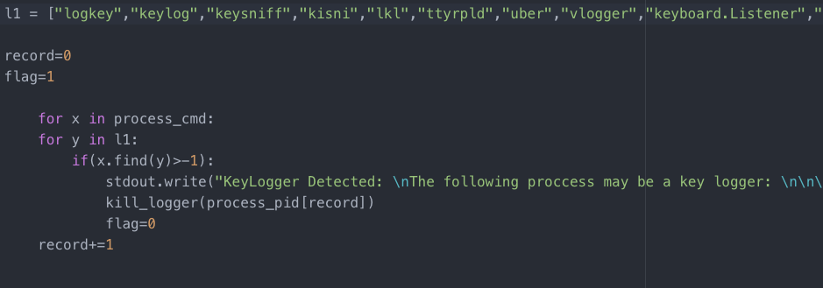
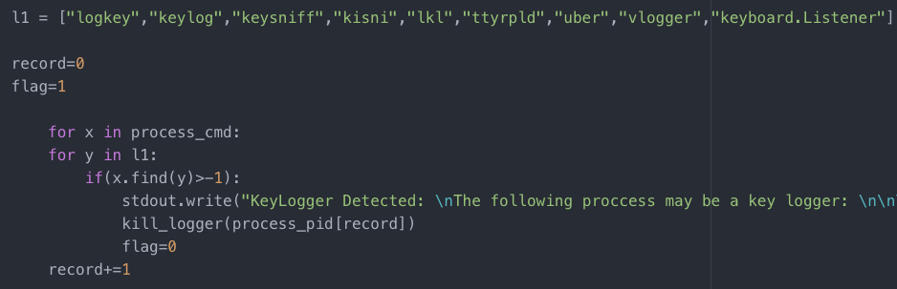
Code Snippet 2 - Detecting based on the process commands

Slide 10
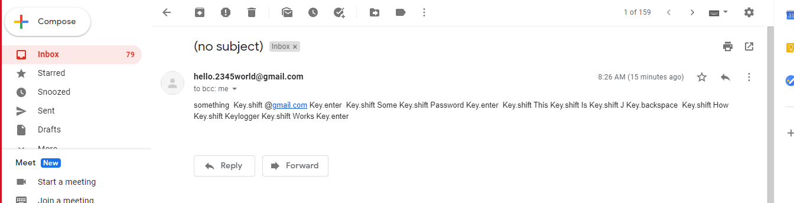
OUTPUT
Output of the keylogger

Slide 11
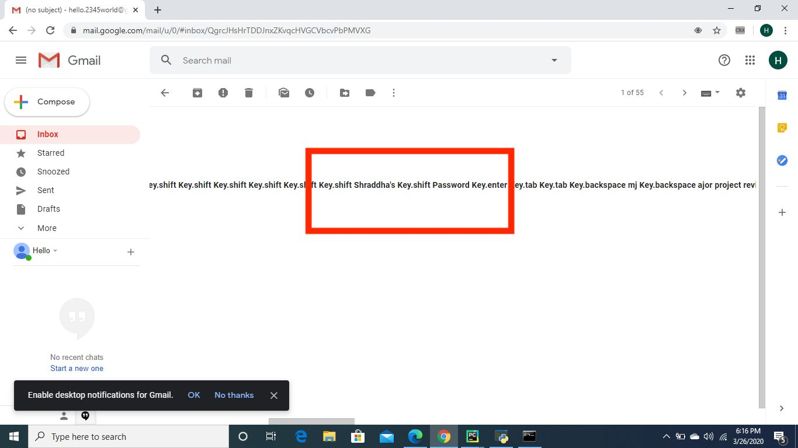

Slide 12
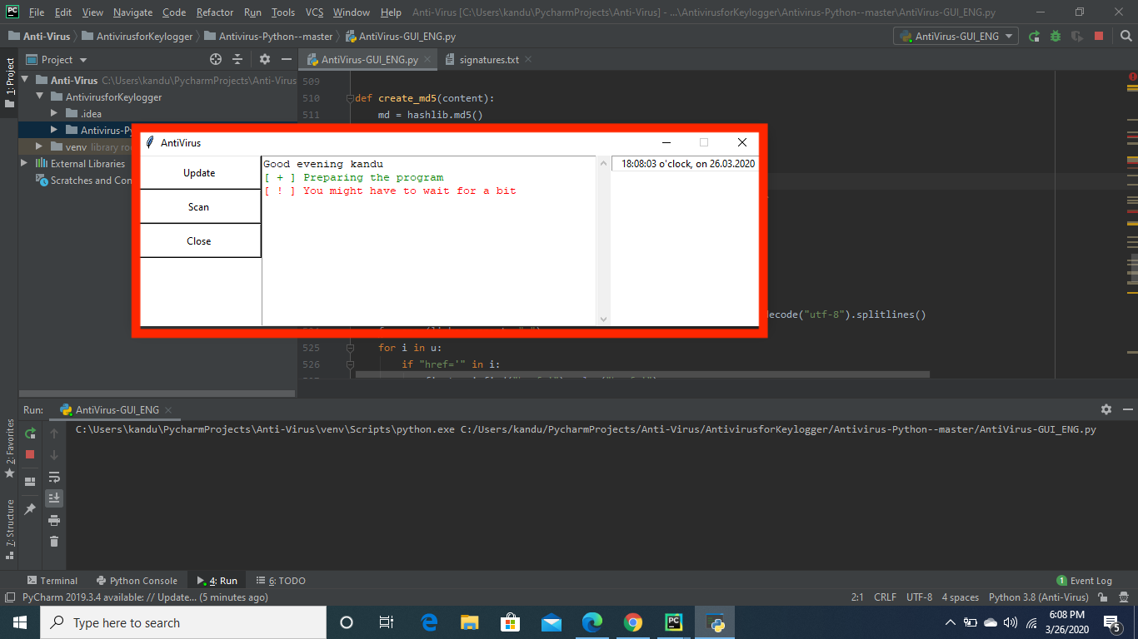
Antivirus output

Slide 14
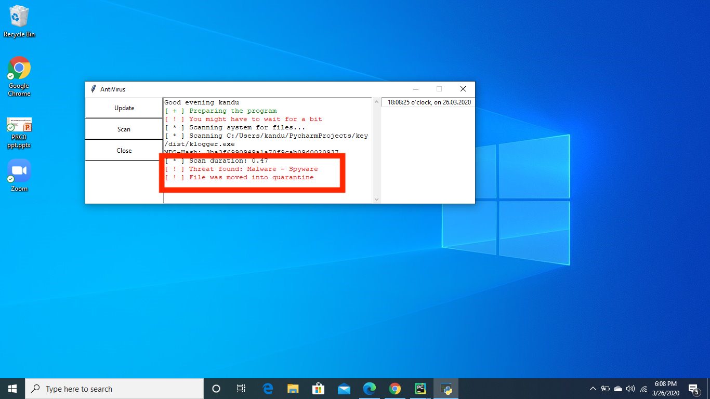

Slide 15
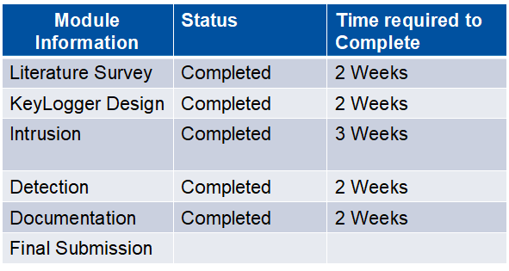
Plan of Action :

Slide 16
References
https://ieeexplore.ieee.org/document/7726880
https://securelist.com/keyloggers-how-they-work-and-how-to-detect-them-part-1/36138/
https://en.wikipedia.org/wiki/Keystroke_logging
http://ijarcet.org/wp-content/uploads/IJARCET-VOL-4-ISSUE-4-1465-1469.pdf

Slide 17
THANK YOU

